Slide 1



BRYTZONE WEB PLATFORM
University of BuEA
College of Technology
Department of Computer Engineering
CEC419 Design Project Topic
bY:
ZONE FRANK JORDAN CT19A089
ASSISTED BY ZONE CORINE CT21A131
SUPERVISED BY
DR MELINGUI M. ROBERT
Date:
9th June 2023

Slide 2
OUTLINE
Introduction
Problem statement
Requirements
Methodology
Analysis and design
Snapshot of Design
Conclusion

Slide 3
INTRODUCTION
Brytzone is a web-based educational platform tailored for African University students, and is focused on helping them stay up-to-date with the latest information in their faculty/school, finding internships, participating in polls to better their academics and most importantly giving them enough exposure to via projects possibly land a job before leaving the university.

Slide 4
PROBLEM STATEMENT
Develop a comprehensive educational platform that addresses the following challenges faced by lecturers and students:
Lack of visibility into student performance
Limited access to internship opportunities
Scarcity of reliable information sources
Bridging the gap between skilled students and job opportunities

Slide 5
REQUIREMENTS
Operating System: Windows 10 Pro
Core i5, 500GB storage, 8GB RAM
Active Internet Connection
Frontend: HTML, SCSS, React.Js(JavaScript), TypeScript
Translation: Next-intl API
Database: Mongo DB
IDE: Visual Studio Code
Web browser: Any
UML diagram: Dia v0.97.2

Slide 6
METHODOLOGY
Data Analytics and Visualization
Internship Aggregation and Matching
Content Curation and Information Dissemination
Networking and Industry Engagement
Feedback Mechanisms and Continuous Improvement

Slide 7
ANALYSIS AND DESIGN
Class diagram

Slide 8
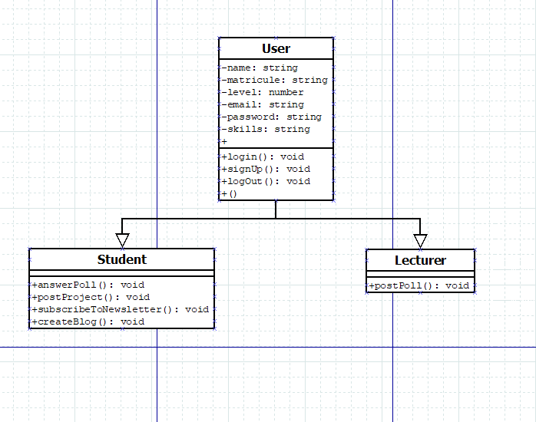
Fig 1.0 BRYTZONE CLASS DIAGRAM

Slide 9
ANALYSIS AND DESIGN
Use Case diagram

Slide 10
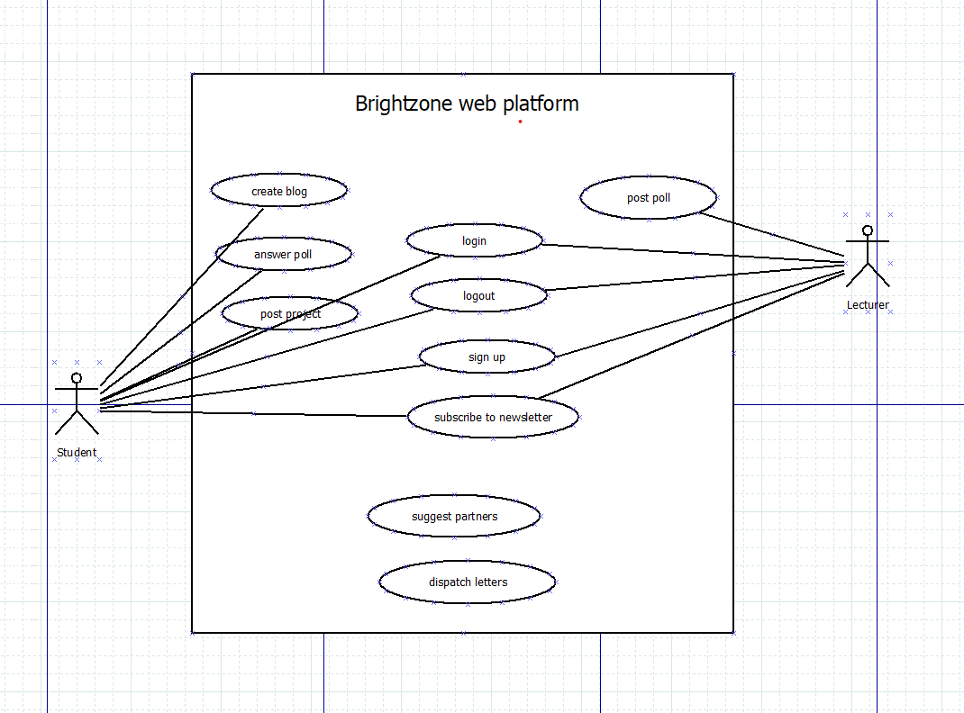
Fig 1.1 BRYTZONE USE CASE DIAGRAM

Slide 11
SNAPSHOTS OF DESIGN

Slide 12
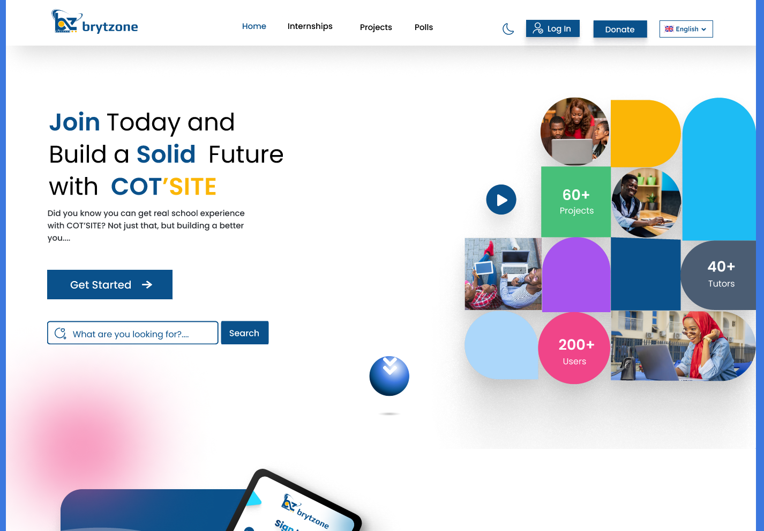
Fig 1.2 BRYTZONE HOME PAGE

Slide 13
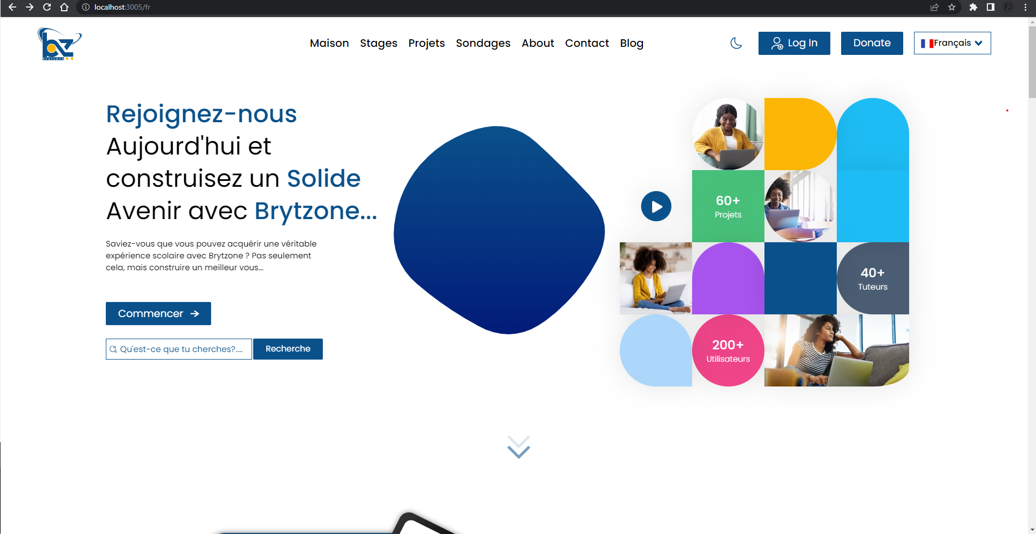
Fig 1.3 BRYTZONE HOME PAGE IN FRENCH

Slide 14
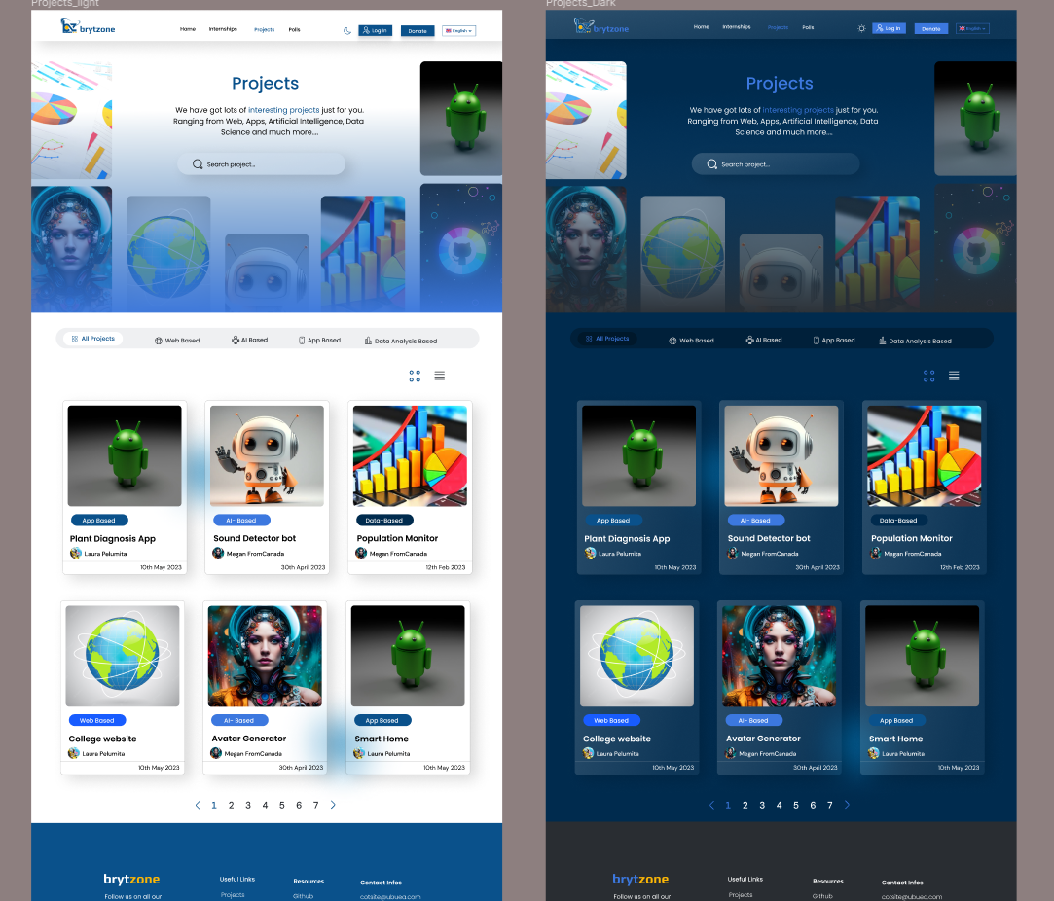
Fig 1.4 BRYTZONE PROJECTS PAGE

Slide 15
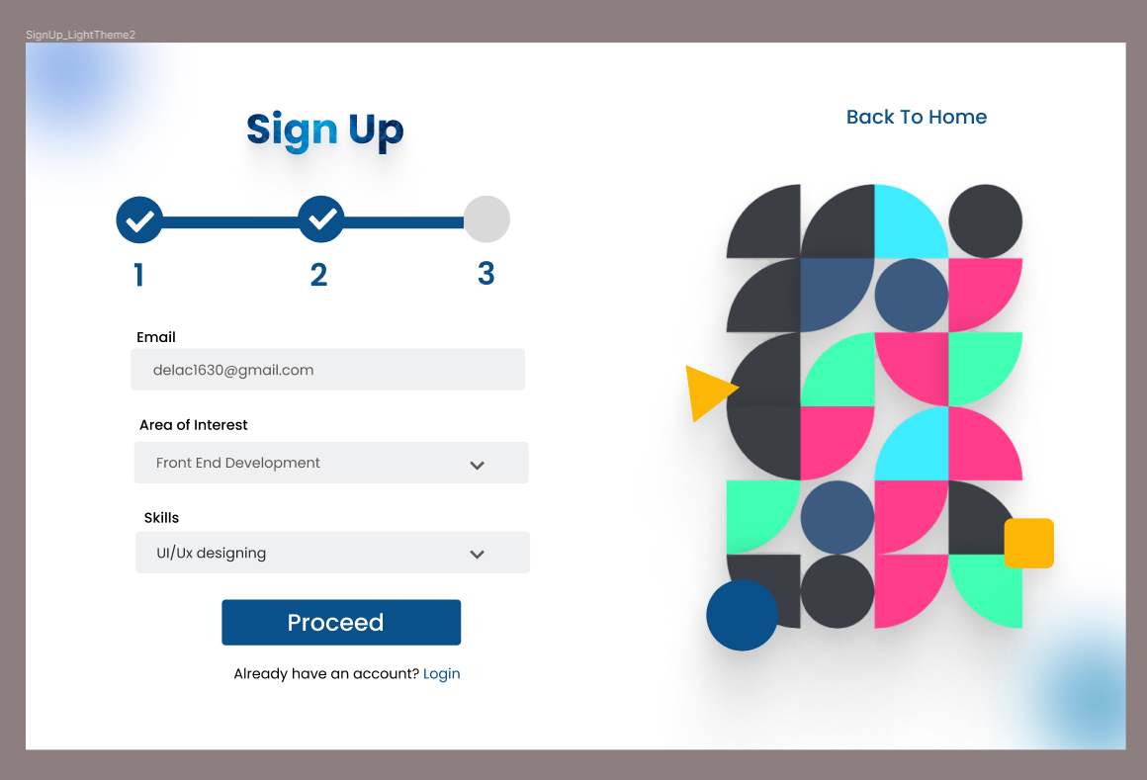
Fig 1.5 BRYTZONE SIGNUPPAGE

Slide 16
CONCLUSION
For this system to be correctly established, the school or faculty in question must accept to lend a hand in running the affairs.
This project would greatly boost student’s overall academic experience.

